Slide 1
Crash Course on Fundamental Algorithms and Data Structures
Elad Verbin
for Data Science Retreat
February 7, 2016

Slide 2
Important Topics
Analysis of Algorithms:
O-notation and Complexity Analysis (time and space)
Pseudocode
Randomized Algorithms and their Analysis
Data Structures
Resizable Arrays (vs lists, …)
Balanced Binary Search Trees (and Augmentations)
Hash
Selecting a Data Representation
Algorithms
Searching
Sorting
Selection
Lower Bounds
BFS, Connected Components
Shortest Paths
Sampling
Strong Techniques
Divide and Conquer / Recursion
Dynamic Programming

Slide 3
Important Topics We Won’t Cover
Pointer Manipulation
e.g. loop detection, other linked list questions
Bit Manipulation and other tricks
e.g. find element that only repeats once when all others repeat twice, with O(1) space
Given a biased coin, create an unbiased coin
Coding on whiteboard, finding bug
Memory Management, Caching
Probability Must-Knows
Linearity of expectation
Drunkard’s Walk
Normal Random Variable
Concentration Bounds, Law of Large Numbers
Design Patterns
Software Design
understanding inheritance
Source Control

Slide 4
Plan
Review topic
Solve exercises
Repeat
concentrate on randomized algorithms

Slide 5

Why?

Slide 6
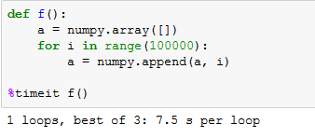
Why?

Slide 7
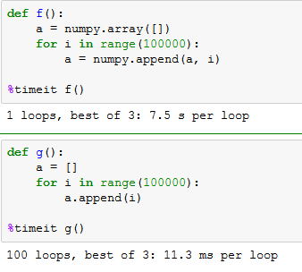
Why?

Slide 8
Why?
Interviews
Why do they ask about these things?
Real-life
Algorithmic thinking
Data manipulation before and after running strong library functions
Defensive: Need to avoid screwing up
Often, memory ends up being the culprit
Offensive: Design good algorithmic approaches

Slide 9
Recommended Resources
Theory
Kleinberg and Tardos Book: “Algorithm Design
Slides: http://www.cs.princeton.edu/~wayne/kleinberg-tardos/
Roughgarden on Coursera
https://www.coursera.org/learn/algorithm-design-analysis/
https://www.coursera.org/learn/algorithm-design-analysis-2
Exercises
Book: “Cracking the Coding Interview" 6th ed.
http://www.geeksforgeeks.org/fundamentals-of-algorithms/
Other
https://www.coursera.org/learn/algorithmic-toolbox/
https://www.coursera.org/learn/cs-tech-interview

Slide 10
Basics

Slide 11
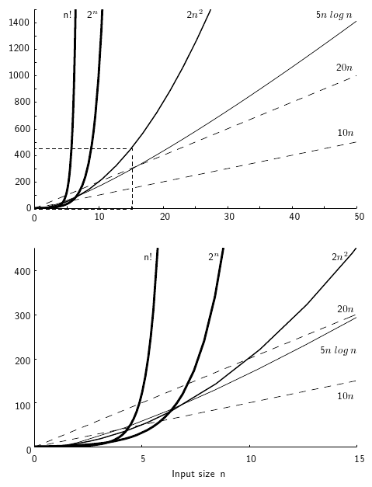
Asymptotic Analysis
With big data comes big responsibility
We ignore constant multiplicative terms
Want to “capture” the running time
O(1) – hash lookup
O(logn) – binary search
O(nlogn) – sorting
O(2^{n}) – naïve algorithm for TSP

Slide 12
O-notation
1000n² + 10¹⁰n = O(n²)
0.0001n³ = Ω(n³)
0.0001n² ≤ f(n) ≤ 1000n² ⇒ f(n) = Θ(n²)
ignore lower order terms.

Slide 13
O-notation
Hierarchy of orders of growth:
10 << loglogn << logn << log³n << n^{0.001} << n^{0.5} << n/log⁵n << n
n << nlog³n << n^{1.001} << n² << n^{logn} << 2^{0.5n} << 2^{n}

Slide 14
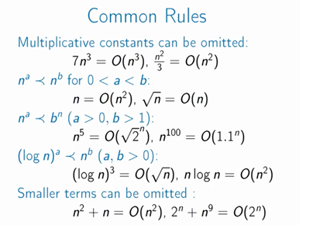

Slide 15
Recurrences
log_{a}(b) = log(b)/log(a)
(a^{b})^{c} = a^{b*c}
log(ab) = log(a) + log(b)
log(a^{b})=b*log(a)
T(n) = T(n/2) + 1. T(n) = ?
T(n) = T(n/2) + O(n). T(n) = ?
T(n) = 2*T(n/2) + n. T(n) = ?
Formal proofs – by induction
Master Theorem
Logarithms and Exponentials
(logn)^{logn} = (2^{loglogn})^{logn} = 2^{logn*loglogn}

Slide 16

Exercise
Exercise: Order the following by asymptotic behavior:
n
n^{logn}
$2^{\log^{4}n}$
2^{√n}
(logn^{)logn}

Slide 17

Solution
Exercise: Order the following by asymptotic behavior:
n << (logn)^{logn} << n^{logn} << ${ 2}^{\log^{4}n}$<< 2^{√n}
Some reasons:
(logn)^{logn} = 2^{loglogn*logn} (= n^{loglogn})
${ 2}^{\log^{4}n}$ = ${ n}^{\log^{3}n}$

Slide 18
Hard Questions
T(n) = T(√n) + 1 ⇒ T(n) = ?
T(n) = 3*T(n/2) ⇒ T(n) = ?
Describe 2^{√logn}
f(n)^{f(n)} = n ⇒ f(n) = ?

Slide 19
Analysis of Algorithms
O-notation: why do we need it. to predict running time, etc.
can profile your code of course, but how do you make sure in advance it'll be quick
how to ensure scalability?
Do constants ever matter?
What does n stand for?
choose your own parameters.

Slide 20
Analysis of Algorithms
Time Complexity, Memory Complexity
How to measure. Pseudocode.
Profiling vs Analysis
Complications:
Randomized?
Amortized?

Slide 21
Algorithms

Slide 22
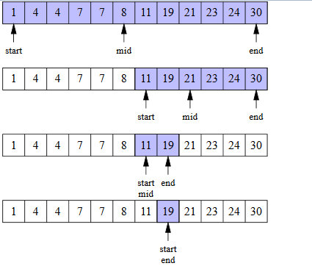
Binary Search
In sorted array: O(logn) time
In unsorted: must perform linear scan. O(n) time.
Many variants.

Slide 23
Exercise
Given an array A which is strictly increasing and then strictly decreasing, and an element x, find x in A

Slide 24
Exercise
Given an array A which is strictly increasing and then strictly decreasing, and an element x, find x in A
Solution: we first find the “spike point” by doing a sort of binary search: when we look at a pair of adjacent elements A[i],A[i+1], if A[i]<A[i+1] then the spike is after I, otherwise the spike is before i. Once we found the spike, we can do a binary search on both sides of it. Complexity = O(logn).

Slide 25
Exercise
Given an array A where A[0]=0, A[n-1]=42, find an index I such that A[i]≠A[i+1].

Slide 26
Exercise
Given an array A where A[0]=0, A[n-1]=42, find an index I such that A[i]≠A[i+1].
Solution: Again, a recursive solution like binary search. At each point in time we keep two indices I, j where i<j and A[i]≠A[j]. The difference j-I will get smaller each time by a factor of two. To do this, we start with i=0 and j=n-1. We then look at A[n/2]. If it is different from A[0], we set j=n/2, else we set i=n/2. Now recurse.

Slide 27
Exercise (hard)
Search for an element in a sorted array where 1% of elements experienced unspecified noise
The 1% were selected at random
Promise: The element we’re looking for did not experience noise

Slide 28
Exercise (hard)
Search for an element in a sorted array where 1% of elements experienced unspecified noise
The 1% were selected at random
Promise: The element we’re looking for did not experience noise
Solution: we want to do binary search, but it’s complicated: what if the middle element experienced noise? We therefore look at the middle 10logn elements, choose their median, and pivot according to it. We can prove that the chance this element is “wrong” is at most 1/n^{0.01} (using concentration bounds). And we can repeat.
Further Question: can we do it faster? (Yes, but requires more work)

Slide 29
QuickSort
QuickSort(A):
choose 1≤i≤n randomly and uniformly
pivot = A[i]
Smaller = {x in A such that x < pivot}
Larger = {x in A such that x ≥ pivot}
Recurse on Smaller and on Larger
A = QuickSort(Smaller) + QuickSort(Larger)
Is this good pseudocode?
Running time = O(nlogn). By induction?
Complexity Analysis of Randomized Algorithm

Slide 30
QuickSelect
Median vs Average
Often people pick average because it’s easier to compute
Select(A,k) = k-th smallest element in A
QuickSelect(A,k):
choose 1≤i≤n randomly and uniformly
pivot = A[i]
pivot_rank = number of elements in A that are ≤ pivot
Smaller = {x in A such that x < pivot}
Larger = {x in A such that x ≥ pivot}
If k≤pivot_rank, return QuickSelect(Smaller,k), else return QuickSelect(Larger, k-pivot_rank)
Running time = O(n). By induction?

Slide 31
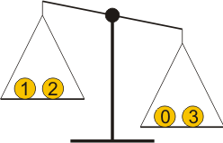
Lower Bounds
You are given 9 coins, and a scale weight. One of the coins weighs less than the others. Find it in a minimum number of weightings.

Slide 32
Lower Bounds
You are given 9 coins, and a scale weight. One of the coins weighs less than the others. Find it in a minimum number of weightings.
Answer: 2
Question: Why not less?

Slide 33
Lower Bounds
Given a sorted array A, find an element x
Question: How many possible answers?

Slide 34
Lower Bounds
Given a sorted array A, find an element x
Question: How many possible answers?
Answer: n
Only allowed comparisons.
Decision tree must have n leaves ⇒ running time >= Ω(logn)

Slide 35
Lower Bounds
Given array A, sort it.
Only allowed comparisons.
Question: How many possible answers?

Slide 36
Lower Bounds
Given array A, sort it.
Only allowed comparisons.
Question: How many possible answers?
Answer: n! (n factorial)
Conclusion: Sorting takes Ω(log(n!)) time if you’re only allowed comparisons
log(n!) = Ω(nlogn)
Always try to think of lower bounds as well
points to an approach for better algorithms

Slide 37
Exercise: The Heavy Pill
You have 20 bottles of pills. 19 bottles have 1.0 gram pills, but one has pills of weight 1.1 grams. Given a scale that provides and exact measurement, how would you find the heavy bottle? You can only use the scale once.

Slide 38
Exercise: The Heavy Pill
You have 20 bottles of pills. 19 bottles have 1.0 gram pills, but one has pills of weight 1.1 grams. Given a scale that provides and exact measurement, how would you find the heavy bottle? You can only use the scale once.
Solution: Obviously this seems to have a lower bound, so we must think outside the box: we need to use the fact that the scale gives many digits of information. Quickly we see that it’s enough to weigh one pill of the first bottle, two pills of the second bottle, three of the third, and so on.

Slide 39
Exercise
Given a sorted array and a number T, find a pair of elements in the array whose sum is closest to T.

Slide 40
Exercise
Given a sorted array and a number T, find a pair of elements in the array whose sum is closest to T.
Solution: Easy in O(n²) time. We’ll do it in O(n) time: It’s pretty similar to the merge step in merge-sort. We scan the array from right to left, and for each element x, our goal is to find the element y such that x+y is less than T but as large as possible, and the element z such that x+z is more than T but as small as possible. Once we find those y and z for each x, we’re done. These y and z are neighbors, and their indices keep increasing and never decrease, so we can just repeatedly move these y and z pointers when needed.
http://quiz.geeksforgeeks.org/given-sorted-array-number-x-find-pair-array-whose-sum-closest-x/

Slide 41
BFS and Shortest Paths
BFS = Breadth First Search
Connected Components
O(n+m)

Slide 42
BFS and Shortest Paths
BFS = Breadth First Search
Connected Components
O(n+m)
Dijkstra = Single Source Shortest Paths.
Greedy.
O(mlogn)
Improvement: O(m + nlogn)

Slide 43
Exercise
You have a 2-dimensional integer matrix representing a plot of land with a number of ponds on it. A zero represents “water”, and any other integer represents solid ground. A “pond” is any region of connected water, and can be connected vertically, horizontally, or diagonally. The “size” of a pond is the total number of connected water cells in the pond. Write a function which computes the sizes of all ponds.

Slide 44
Exercise
You have a 2-dimensional n by n integer matrix representing a plot of land with a number of ponds on it. A zero represents “water”, and any other integer represents solid ground. A “pond” is any region of connected water, and can be connected vertically, horizontally, or diagonally. The “size” of a pond is the total number of connected water cells in the pond. Write a function which computes the sizes of all ponds.
Solution: Transform the matrix to a graph. Any zero turns to a vertex, and any two adjacent zeros turn to an edge. Time = O(n²)
Wrong Solution: Reinventing the wheel, i.e. implementing search on the matrix from scratch, without using a black box. Reuse is very important!

Slide 45
Exercise
Given two words of equal length that are in a dictionary, write a method to transform one word into another word by changing only one letter at a time. The new word you get in each step must be in the dictionary.

Slide 46
Exercise
Given two words of equal length that are in a dictionary, write a method to transform one word into another word by changing only one letter at a time. The new word you get in each step must be in the dictionary.
Solution: Build a graph over the dictionary. Each word is a vertex. Each two words that can be transformed by changing one letter create an edge. You want to find a path between the two words. Complexity is O(n²) where n is the number of words in the dictionary.

Slide 47
Exercise
Given two words of equal length that are in a dictionary, write a method to transform one word into another word by changing only one letter at a time. The new word you get in each step must be in the dictionary.
Solution: Build a graph over the dictionary. Each word is a vertex. Each two words that can be transformed by changing one letter create an edge. You want to find a path between the two words. Complexity is O(n²) where n is the number of words in the dictionary.
Even better: O(n² + nd) where d is the maximum length of a word. (Or O(ndΣ) where Σ is the alphabet size, by noticing that there are at most ndΣ edges)
You also might want to find a shortest path

Slide 48
Sampling
Reservoir Sampling:
Given a stream of elements with unknown length, return a uniformly random element from the stream

Slide 49
Sampling
Reservoir Sampling:
Given a stream of elements with unknown length, return a uniformly random element from the stream
Solution:
x = first element
with probability 1/2, x = second element
with probability 1/3, x = third element
…

Slide 50
Data Structures

Slide 51
Choosing a data representation
Need to know the asymptotic running times:
of the library DSs you choose
of the primitive DSs in your language (python: dictionary, set, list, numpy array, pandas dataframe)
better know a bit about the implementation
need to distinguish what we need and don’t need to know:
exact sorting method -- unimportant
implementation type of list – important (tradeoffs)
But beware of pre-optimizing

Slide 52
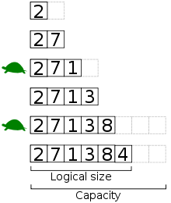
Resizable Arrays
Time complexity?
O(1) amortized
Banking method
“Incremental resizing”
Space consumption: should we resize to smaller?
slack
Making other DS resizable
Pointer based DS are not size-limited. Array based (e.g. hash) – similar tricks

Slide 53
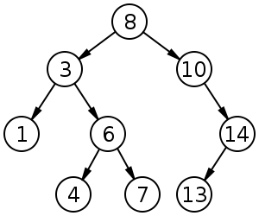
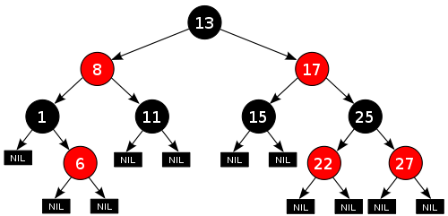
Balanced Search Trees
Not every tree is a search tree
Not every search tree is a balanced search tree
2-3, B-trees, AVL, splay, skip lists
Insert, Delete, Find – O(logn)
find(x) = returns maximum y in tree s.t. y≤x
Can use BST as Heap
Can use BST to sort

Slide 54
Balanced Search Trees
Implementation: Complicated.
Based on rotations.
Difference between Balanced Search Trees
and normal Search Trees?
slack
Augmentations:
linked list on items (finger search trees)
Adding info in nodes:
info about subtree (Order statistic tree)
info about root-to-node path
Interval Tree
Need to preserve these during rotations

Slide 55
Exercise: RandomNode
We are implementing a binary search tree from scratch, which in addition to the operations insert, delete and find, also has an operation RandomNode() which returns a uniformly random node from the tree. How would you implement such a tree?

Slide 56
Exercise: RandomNode
We are implementing a binary search tree from scratch, which in addition to the operations insert, delete and find, also has an operation RandomNode() which returns a uniformly random node from the tree. How would you implement such a tree?
Solution: Maintain subtree size counts. To select a node, start from root and walk down the tree. Each time choose which side to go based on a randomly chosen number between 0 and 1, and the subtree counts of the children (how?).
Perhaps better solution: store all elements in a resizable array with two-sided pointers to the corresponding tree node. Then RandomNode() would just pick a random element from the array.

Slide 57
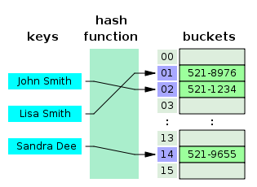
Hash Tables
Pervasive in modern languages
O(1) insert, O(1) delete, O(1) lookup.
No ordering info.
“Hashable values”, mutability
“Closed Hash” vs “Open Hash”
“Open Hash” – can augment, e.g. instead of linked list in cell, put a different data structure
Resizable Hash Table
Security, “collision attacks”
Collision Riddles

Slide 58
Exercise
Given two strings s and t, write a function that checks whether t is a permutation of s

Slide 59
Exercise
Given two strings s and t, write a function that checks whether t is a permutation of s
Solution: create a hash table, where each element is augmented with two counters: one for s and one for t. Go over the characters of s and augment the s-counters, go over the characters of t and augment the t-counters, then go over all elements in the hash table (how do we do that?) and check whether the two counters are equal.

Slide 60
Exercise
Given an array of integers, find the length of the largest subarray with sum equal to 0.

Slide 61
Exercise
Given an array of integers, find the length of the largest subarray with sum equal to 0.
Solution: naïve algorithm – O(n²). Better algorithm: linear time. Scan the array left to right, computing the sum of each prefix. Hash these sums; for each unique sum, collect all the prefixes with that sum, find the minimum m and maximum M ones: the subarray [m+1,M] has sum zero. Do this for all possible unique sums, and choose the largest subarray that you found.
http://www.geeksforgeeks.org/find-the-largest-subarray-with-0-sum/

Slide 62
Hash vs Binary Search Tree?

Slide 63
Hash vs Binary Search Tree?
When the ordering matters, often BST is right. When the ordering doesn’t matter, often Hash is right.
Of course, other structures exist.
Variants of Hash and BST
Hash with BST in cells
Heap
Union Find
…
Choose your data representation carefully.

Slide 64
Exercise
Given an n by n matrix A as input, return a matrix B which is identical to A except that if an element is zero, then its entire row and column are set to zero

Slide 65
Exercise
Given an n by n matrix A as input, return a matrix B which is identical to A except that if an element is zero, then its entire row and column are set to zero
Solution: create bit-vector for rows that contain zeros and columns that contain zeros. Scan array one element at a time, and in O(1) time, zero it out if needed.
Complexity: O(n²), which is optimal
Advanced Question: What is the space complexity? Can you improve it?

Slide 66
Strong Techniques

Slide 67
Divide and Conquer
Recursion

Slide 68
Exercise
Given a sorted array in which all elements appear twice (one after another) and one element appears only once, find that element.

Slide 69
Exercise
Given a sorted array in which all elements appear twice (one after another) and one element appears only once, find that element.
In O(logn) complexity.

Slide 70
Exercise
Given a sorted array in which all elements appear twice (one after another) and one element appears only once, find that element.
In O(logn) complexity.
Solution: Divide and conquer. Split in the middle, look locally, go in the right direction.

Slide 71
Exercise
Given a length-n sorted array of positive integers, count the number of occurrences of each element in the array.

Slide 72
Exercise
Given a length-n sorted array of positive integers, count the number of occurrences of each element in the array.
Solution: O(n).
Assume all elements in the array are less than some small constant m. Can we do it faster, as a function of m and n?

Slide 73
Exercise
Given a length-n sorted array of positive integers, count the number of occurrences of each element in the array.
Solution: O(n).
Assume all elements in the array are less than some small constant m. Can we do it faster, as a function of m and n?
Solution: Can do O(mlogn): take middle element, find its first occurrence on the left, its last occurrence on the right (total O(logn) time). Repeat on the rest.
T(n,m) = logn + T(n,m-k-1) + T(n,k). Solves to T(n,m) ≤ O(mlogn).
Final complexity: O(min(n, mlogn))
Discussion: Complexity that depends on two parameters

Slide 74

Dynamic Programming
DP = Recursion plus Memoization
DP is a time space tradeoff: you store more space, to save time
Often need to choose the variables smartly for the recursion
Running time = ?

Slide 75
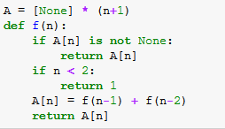
Dynamic Programming
DP = Recursion plus Memoization
DP is a time space tradeoff: you store more space, to save time
Often need to choose the variables smartly for the recursion
O(c^n)
O(n)

Slide 76
Exercise
Given an arithmetic expression without parentheses, place parentheses to maximize the value of the expression
5 + 6 * 7 + 8
(5 + 6) * (7 + 8)

Slide 77
Greedy
Also local search
A*

Slide 78
Conclusions

Slide 79
What have we learned
Algorithmic thinking is useful when coding, and when interviewing
Often it’s just a matter of thinking abstractly and planning
But don’t pre-optimize
Always give the naïve solution first. Then try to improve, while simultaneously looking for reasons why it might be impossible to improve
If the problem is difficult, maybe try to attack simpler problems, small cases or special cases

Slide 80
Recommended Resources
Theory
Kleinberg and Tardos Book: “Algorithm Design
Slides: http://www.cs.princeton.edu/~wayne/kleinberg-tardos/
Roughgarden on Coursera
https://www.coursera.org/learn/algorithm-design-analysis/
https://www.coursera.org/learn/algorithm-design-analysis-2
Exercises
Book: “Cracking the Coding Interview" 6th ed.
http://www.geeksforgeeks.org/fundamentals-of-algorithms/
Other
https://www.coursera.org/learn/algorithmic-toolbox/
https://www.coursera.org/learn/cs-tech-interview

Slide 81
Important Topics We Covered
Analysis of Algorithms:
O-notation and Complexity Analysis (time and space)
Pseudocode
Randomized Algorithms and their Analysis
Data Structures
Resizable Arrays (vs lists, …)
Balanced Binary Search Trees (and Augmentations)
Hash
Selecting a Data Representation
Algorithms
Searching
Sorting
Selection
Lower Bounds
BFS, Connected Components
Shortest Paths
Sampling
Strong Techniques
Divide and Conquer / Recursion
Dynamic Programming

Slide 82
Important Topics We Didn’t Cover
Pointer Manipulation
e.g. loop detection, other linked list questions
Bit Manipulation and other tricks
e.g. find element that only repeats once when all others repeat twice, with O(1) space
Given a biased coin, create an unbiased coin
Coding on whiteboard, finding bug
Memory Management, Caching
Probability Must-Knows
Linearity of expectation
Drunkard’s Walk
Normal Random Variable
Concentration Bounds, Law of Large Numbers
Design Patterns
Software Design
understanding inheritance
Source Control

Slide 83
Extra Exercise 1
Given array A where each element appears twice except one element x that appears once, find x.

Slide 84
Extra Exercise 1
Given array A where each element appears twice except one element x that appears once, find x.
Use O(1) space and O(n) time.

Slide 85
Extra Exercise 1
Given array A where each element appears twice except one element x that appears once, find x.
Use O(1) space and O(n) time.
Solution: XOR all elements. The result is x.

Slide 86
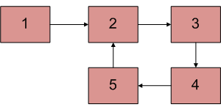
Extra Exercise 2
Given a linked list, check if the linked list has a loop or not.

Slide 87
Extra Exercise 2
Given a linked list, check if the linked list has a loop or not.
Only use two pointers

Slide 88
Extra Exercise 2
Given a linked list, check if the linked list has a loop or not.
Only use two pointers
Solution: start both pointers at the head. At each step, progress one by 1 step, and the other by 2 steps. If they meet, there is a loop, if they don’t, there isn’t. O(n) time.

Slide 89
Extra Exercise 3
What is the distribution of heights in the population?
Why?

Slide 90
Extra Exercise 4
What is inheritance? How is it implemented?

Slide 91
The End.

